Slide 1




International Conference on Research and Development in Information,
Communication, and Computing Technologies (ICRDICCT’25)
Open Access Conference Proceedings April 4th & 5th, 2025

Slide 2
Paper Presentation Details
Paper Title: Predictive Analytics and Generative AI for Customer Churn Prediction and Proactive Retention
Paper ID: ICRDICCT- 063
Author(s): Anju Thomas, Tamizh Murugan T, Constance Xavier S

Slide 3
Table of Contents
1. Abstract
2. Introduction
3. Related Work / Survey
4. Proposed System / Methodology
5. Experimental Setup / Results
6. Analysis / Discussion
7. Conclusion
8. References

Slide 4
Abstract
A churn prediction system employs advanced analytics and machine learning to forecast customers likely to disengage from a business. By leveraging data from transaction histories, behavioral patterns, engagement levels, and customer feedback, the system enables proactive retention measures, mitigating revenue loss and enhancing business sustainability. Key components include data preprocessing, feature selection, predictive modeling, and insights generation. The integration of generative AI further refines prediction accuracy and frequency, allowing timely interventions to retain potential churners.

Slide 5
Introduction
The churn prediction relies on robust data representation, enhanced feature engineering, and advanced textual data mining. Refining features to capture relevant information and utilizing NLP techniques like sentiment analysis and topic modeling improve model accuracy. Continuous refinement through feedback loops and crowdsourcing ensures models stay updated and effective. As customer churn increases due to product comparisons, poor service, and pricing issues, businesses must focus on retention over acquisition. Leveraging data analytics, improving customer experiences, and refining predictive models help minimize churn and drive long-term customer relationships.

Slide 6
Related Work / Survey
Inadequate Feature Engineering and Textual Data Mining:
Ineffectiveness of Feedback Loops and Crowdsourcing
Limited Effectiveness of Machine Learning Classifiers
Inefficiency in Data Balancing Techniques

Slide 7
Proposed System / Methodology
Utilize supervised machine learning algorithms, such as Random Forest, to predict customer churn based on historical data and derive actionable insights for retention strategies.
Provide comprehensive visualizations, such as correlation heatmaps, distribution plots, and churn reason analyses, to enhance understanding of customer behavior and churn patterns.
Implement natural language processing (NLP) techniques, including text vectorization (TF-IDF) and classification models, to identify reasons for customer dissatisfaction from textual feedback.
Integrate transformer models for summarizing customer feedback, enabling concise and actionable summaries for decision-making.

Slide 8
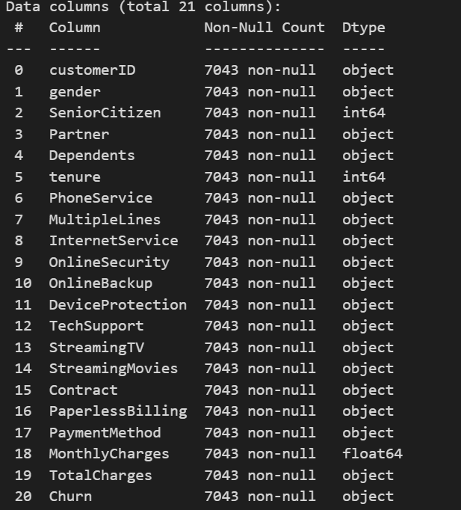
Experimental Setup / Results

Slide 9
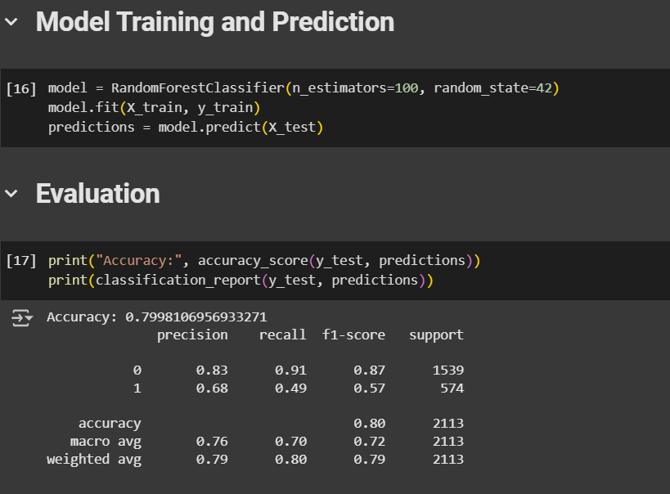
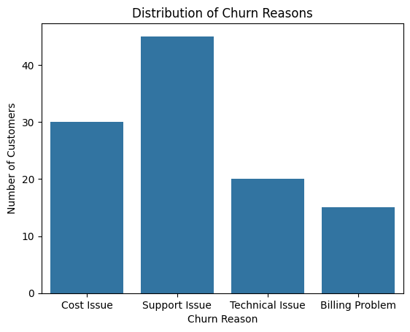

Slide 10
Analysis / Discussion
The analysis of tenure and monthly charges reveals key insights into customer retention and churn behavior.
Tenure distribution shows peaks at 0 and 70+ months, indicating a mix of new sign-ups and long-term users, with early contract terminations likely contributing to the high frequency at zero months.
Monthly charges follow a right-skewed pattern, with most customers in the lower charge range (~20) and another peak between 70-100, suggesting a divide between basic plan users and premium subscribers.
Churn analysis by contract type indicates that higher monthly charges correlate with increased churn risk, especially in Contract Type 0. Additionally, Internet Service Type 1 exhibits a high churn rate, possibly due to pricing or service quality issues, while Types 0 and 2 show better retention.
These insights highlight the importance of cost management and service improvements in reducing churn and enhancing customer retention.

Slide 11
Conclusion
This study introduces a churn prediction method that combines feature engineering, machine learning models, and possible deep learning advancements for improved client retention analysis. The pipeline consists of data preparation (missing value imputation, label encoding, and feature scaling) and model training with Random Forest and Logistic Regression. The results indicate that the system:
Outperforms simple models using feature engineering and ensemble learning.
Handles categorical and numerical data efficiently, resulting in reliable predictions even with skewed datasets.
Provides interpretability through feature significance analysis, which assists organizations in identifying major churn factors.

Slide 12
Reference
[1] Mitra Madanchian, “Generative AI for Consumer Behavior Prediction: Techniques and Applications”, MDPI, 2024.
[2] Alin-Gabriel Văduva, Simona-Vasilica Oprea, AndreeaMihaela Niculae, Adela Bâra Anca-Ioana Andreescu, “Improving Churn Detection in the Banking Sector: A Machine Learning Approach with Probability Calibration Techniques”, MDPI, 2024.
[3] Maryam Shahabikargar, Amin Beheshti, Wathiq Mansoor, Xuyun Zhang, Jin Foo, “Generative AI-enabled Knowledge Base Fine-tuning: Enhancing Feature Engineering for Customer Churn”, Research Gate, 2024

Slide 13
[4] Meryem Chajia, El Habib Nfaoui, “Customer Churn Prediction Approach Based on LLM Embeddings and Logistic Regression”, MDPI, 2024
[5] Aditi Chaudhary, Ali Rizvi, Navneet Kumar, Ashish Kumar Mishra, “A Novel Approach for Customer Churn Prediction in Telecom using Machine Learning Models”, Research Square, 2023
[6] Nomanahmad Haitham Nobanee Mazharjaved Awan, Azlan Mohdzain Ansar Naseem and Amena Mahmoud, “Customer Personality Analysis for Churn Prediction Using Hybrid Ensemble Models and Class Balancing Techniques”, Institute of Electrical and Electronics Engineers(IEEE) Access, 2024

Slide 14
[7] RajaGopal Kesiraju VLN P. Deeplakshmi, “Dynamic Churn Prediction using Machine Learning Algorithms - Predict your customer through customer behavior”, International Conference on Computer Communication & Informatics (ICCCI), 2021
[8] Yihui Deng, Dingzhao Li, Lvqing Yang, Jintao Tang, Jiangsheng Zhao, “Analysis and prediction of bank user chum based on ensemble learning algorithm”, IEEE International Conference on Power Electronics, Computer Applications (ICPECA), 2021
[9] Karsten Rothmeier, Nicolas Pflanzl, Joschka A. H¨ Ullmann, Mike Preuss, “Prediction of Player Churn and Disengagement Based on User Activity Data of a Freemium Online Strategy Game”, IEEE Transaction on Games, 2020

Slide 15
[10] Prasanth Senthan, RMKT Rathnayaka, Banujan Kuhaneswaran, BTGS Kumara, “Development of Churn Prediction Model using XGBoost – Telecommunication Industry in Sri Lanka”, IEEE International IoT, Electronics and Mechatronics Conference (IEMTRONICS), 2021

Slide 16
Thank You

